Slide 1
Informed Search Strategies

Slide 2
Informed Search Strategies
Informed search
Informed search algorithms use problem specific knowledge called a heuristic, to find the solution faster.
Heuristic
A heuristic is just a guess of how close we are to the goal from the current point. It helps the algorithm choose which path looks better to explore next, instead of checking every possible path.
In general, it generates good solution, sometime optimal and sometime quite optimal, uses less memory, less time

Slide 3
What is heuristic function?
h() >= 0 for all nodes
h(n) close to 0 means n is close to the goal
h(n) very large means the goal is far from n
if n is a goal node, then h(n) = 0
Example of a heuristic function in pathfinding:
Euclidean distance (straight-line distance between two points).

Slide 4
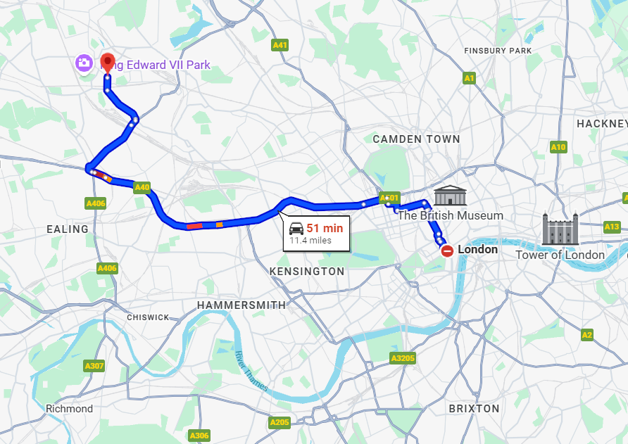

Slide 5
Why Informed Search?
Efficiency: Solves problems much faster than blind search.
Direction: Uses "hints" to move towards the goal, rather than wandering.
Resource Saving: Uses less memory and computing power by ignoring bad paths.

Slide 6
Greedy Best-First Search (GBFS)
Greedy best-first search tries to expand the node that is closest to the goal because it is likely to lead to a solution quickly. Fast but not optimal.
It evaluates nodes by using just the heuristic function
Pros
Uses a heuristic → fast and efficient in many cases
Often explores fewer nodes than BFS/DFS
Works well when heuristic gives good estimates
Cons
Not optimal → may NOT find the best/shortest path
Not complete → can get stuck in loops if not handled

Slide 7
A
7
D
Straight line distance
25
Node | h(n)
A | 40
B | 32
C | 25
D | 35
E | 19
F | 17
H | 10
G | 0
14
10
F
11
C
20
B
8
10
G
15
9
H
E

Slide 8
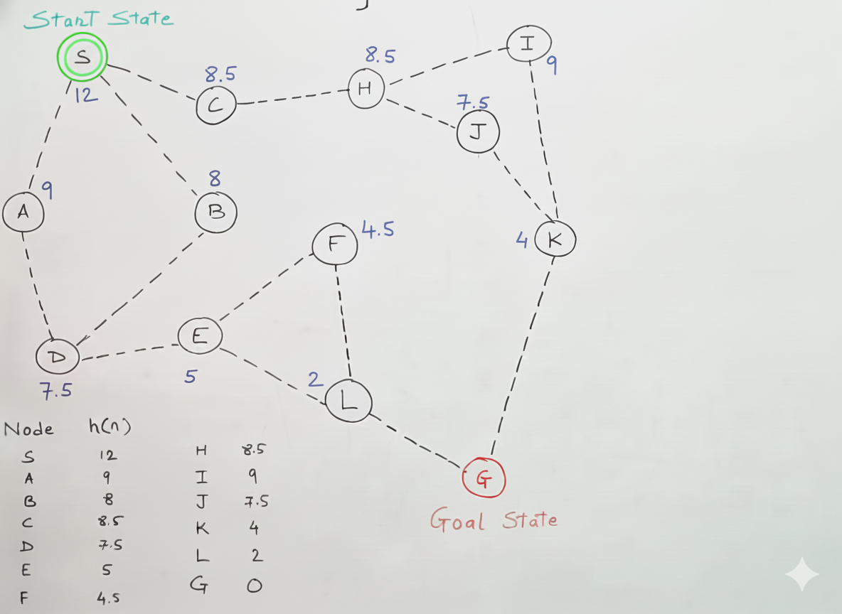

Slide 9
A* Search
A* search is an informed search algorithm that combines the advantages
of both Uniform Cost Search and Greedy Best-First-Search.
A* uses f(n)=g(n)+h(n).
actual cost + estimated cost.
Optimal if heuristic is admissible.

Slide 10
12
5
B
F
16
4
11
12
Z
A
3
14
C
E
5
11
10
4
7
2
D
6
f(n) = g(n) + h(n)
Exact cost
heuristic cost

Slide 11
Why A* Is Powerful
Complete
A* is complete if the search space is finite and the heuristic function is admissible (never overestimates the actual cost)
Optimality
A* search is optimal if the heuristic function is admissible and consistent

Slide 12
Local Search Algorithms
Improves a single current solution.
Used in very large search spaces.

Slide 13
Why Local Search?
Low memory usage.
Good for optimization.
Examples: UI layout tuning, ML parameter tuning.

Slide 14
Types of Local Search
Hill Climbing
Simulated Annealing
Genetic Algorithms

Slide 15
Hill Climbing Example
UI auto-layout optimizer adjusting spacing to improve layout.

Slide 16
Simulated Annealing Example
AI scheduler tries many random task schedules early, refined later.

Slide 17
Genetic Algorithm Example
Automatically generating optimized test cases using mutation & crossover.

Slide 18
Comparison Table
Greedy: Fast, not optimal.
A*: Optimal & complete.
Local search: Good for optimization.

Slide 19
Recap
Heuristics guide informed search.
Greedy = fast.
A* = optimal.
Local = optimization-focused.

